Slide 1

Topic- NLP to detect mental illnesses among social media users
ISM 6905 –Independent Study
Dr. Balaji Padmanabhan
MENTOR: Negar Maleki
Student: Adhithyan Rangarajan

Slide 2
Overview
Step 1 – Literature Review- Performed a literature review ,understood problem significance & methodology used by researchers on predicting mental illness using social media data.
Step 2 – Methodology for Data Retrieval – Understood the population density weightage in Florida and pulled data from twitter based on it.
Step 3 – Twitter Test Data Sample Volume – 408000 tweets in our sample pulled using Geo-location and City Names.
Step 4 – Reddit Mental Health Data for training – 344000 reddit mental health posts were used to train our ML models.
Step 5 – ML Models - Ran the trained better ML model on twitter data for prediction for testing.
Step 6 - Analysis & Recommendations for the State of Florida & Florida Blue.

Slide 3
Literature Review & Papers
Here are the papers that were used as reference to understand the domain, problem and methodology.
PAPER | LINK
Ananthakrishnan, Uttara M and Tucker, Catherine E., The Drivers and Virality of Hate Speech Online (January 28,2022) | https://ssrn.com/abstract=3793801 or http://dx.doi.org/10.2139/ssrn.3793801
Sharath Chandra Guntuku, David B Yaden, Margaret L Kern, Lyle H Ungar, Johannes C Eichstaedt, Detecting depression and mental illness on social media: an integrative review, Current Opinion in Behavioral Sciences, Volume 18, 2017, Pages 43-49, ISSN 2352-1546 | https://doi.org/10.1016/j.cobeha.2017.07.005 or https://www.sciencedirect.com/science/article/pii/S2352154617300384
NLP Model for Effect of Social Media on Health. Duncan, Brianni | http://hdl.handle.net/1920/12187
Conway M, O'Connor D. Social Media, Big Data, and Mental Health: Current Advances and Ethical Implications. Curr Opin Psychol. 2016 Jun;9:77-82 | doi: 10.1016/j.copsyc.2016.01.004. PMID: 27042689; PMCID: PMC4815031.
Babu, N.V., Kanaga, E.G.M. Sentiment Analysis in Social Media Data for Depression Detection Using Artificial Intelligence: A Review. SN COMPUT. SCI. 3, 74 (2022). | https://doi.org/10.1007/s42979-021-00958-1
Coppersmith G, Leary R, Crutchley P, Fine A. Natural Language Processing of Social Media as Screening for Suicide Risk. Biomedical Informatics Insights. January 2018 | doi:10.1177/1178222618792860
Kim, J., Lee, J., Park, E. et al. A deep learning model for detecting mental illness from user content on social media. Sci Rep 10, 11846 (2020). | https://doi.org/10.1038/s41598-020-68764-y

Slide 4
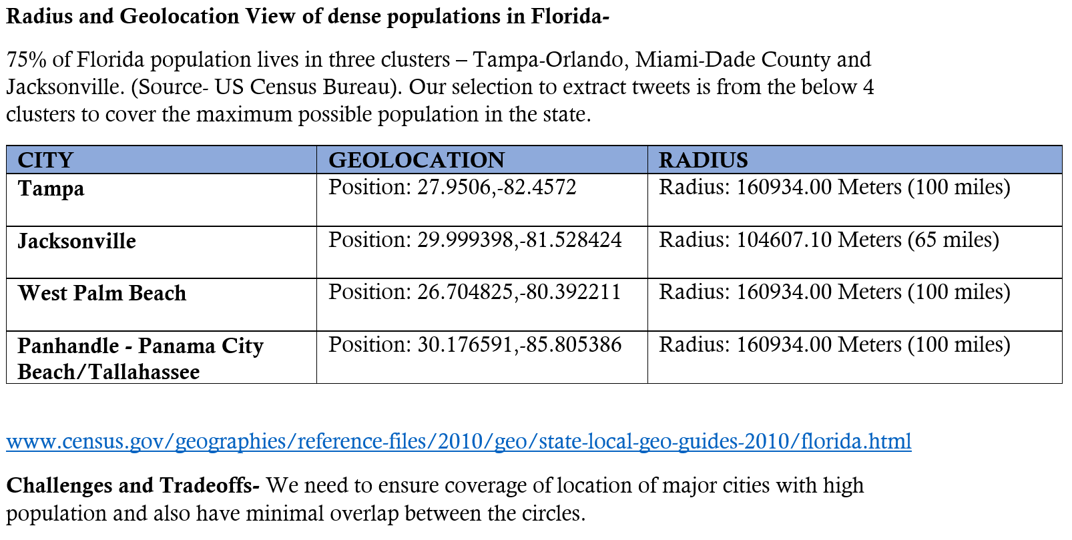
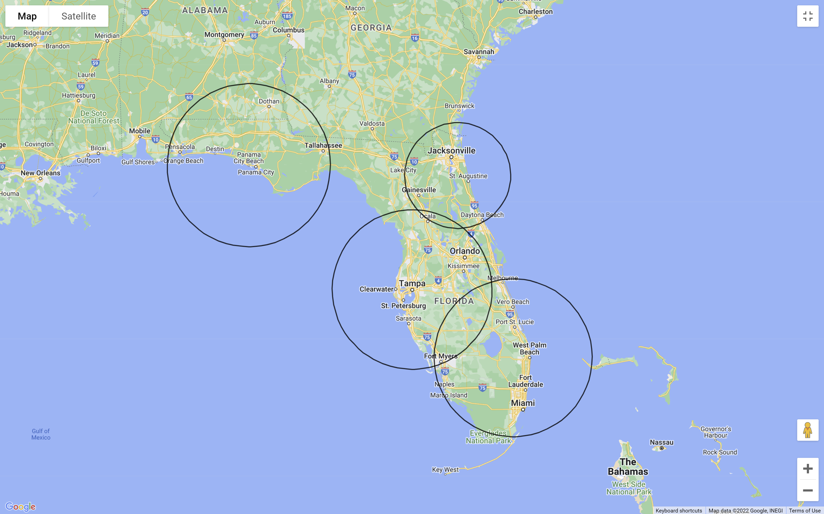
Methodology for Data Retrieval
Four clusters in Florida were used to pull the tweets for our dataset. These include Tampa, Miami, Jacksonville and the Panhandle.

Slide 5
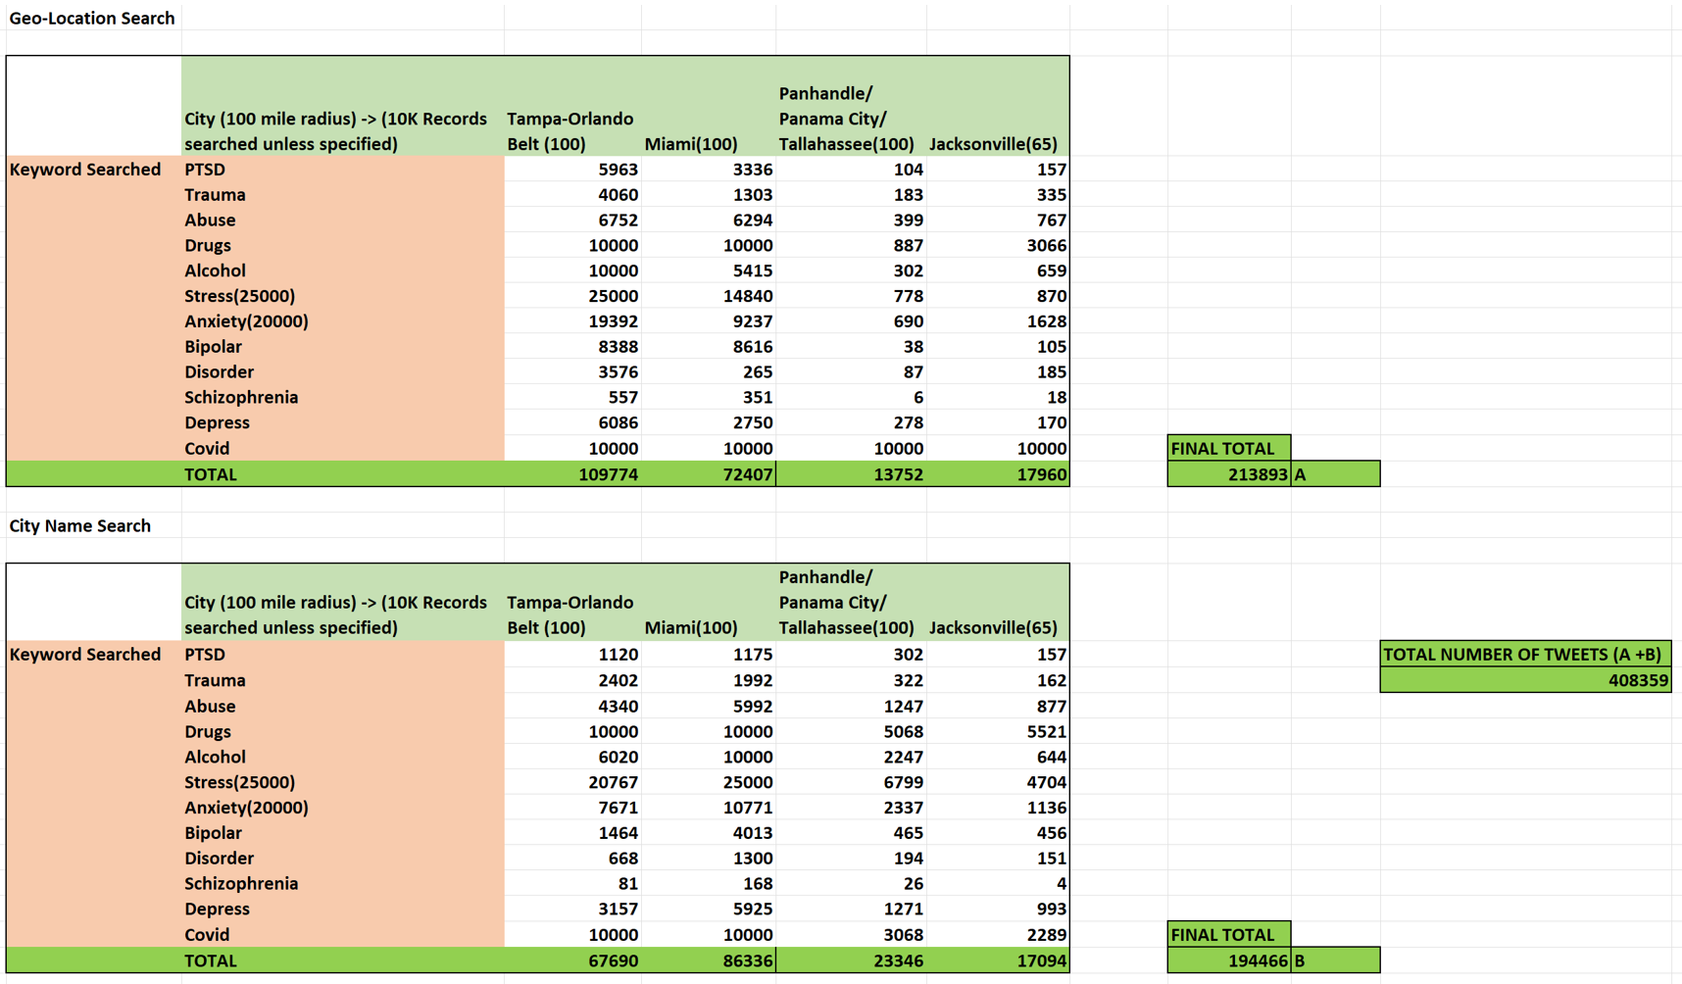
Data Sample Volume
Total of 408K tweets were pulled- 213K using Geo-Location & 194K using City Name to form our final dataset.

Slide 6
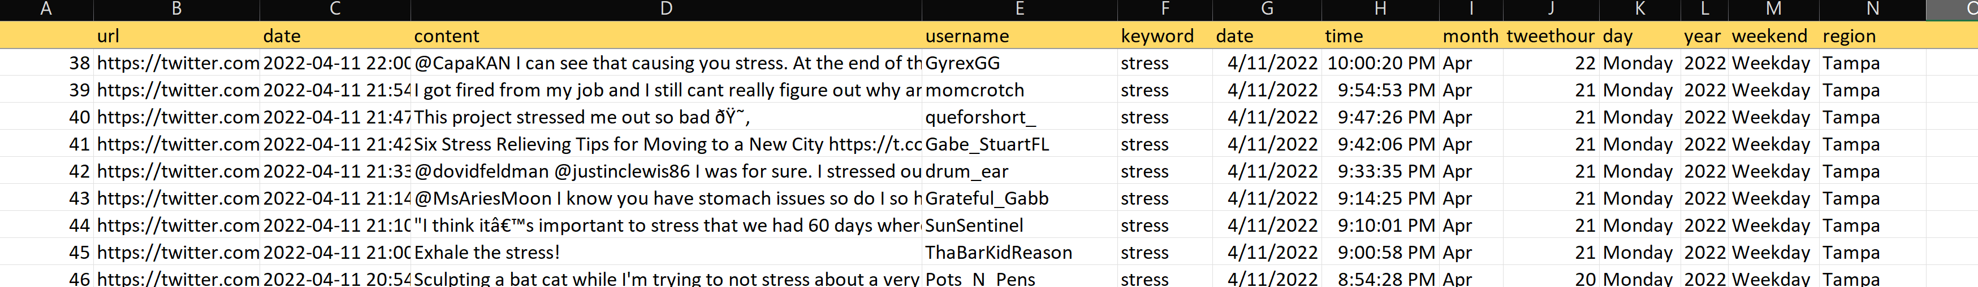
Twitter Dataset Sample
Post data extraction, this is a preview of the final dataset.

Slide 7
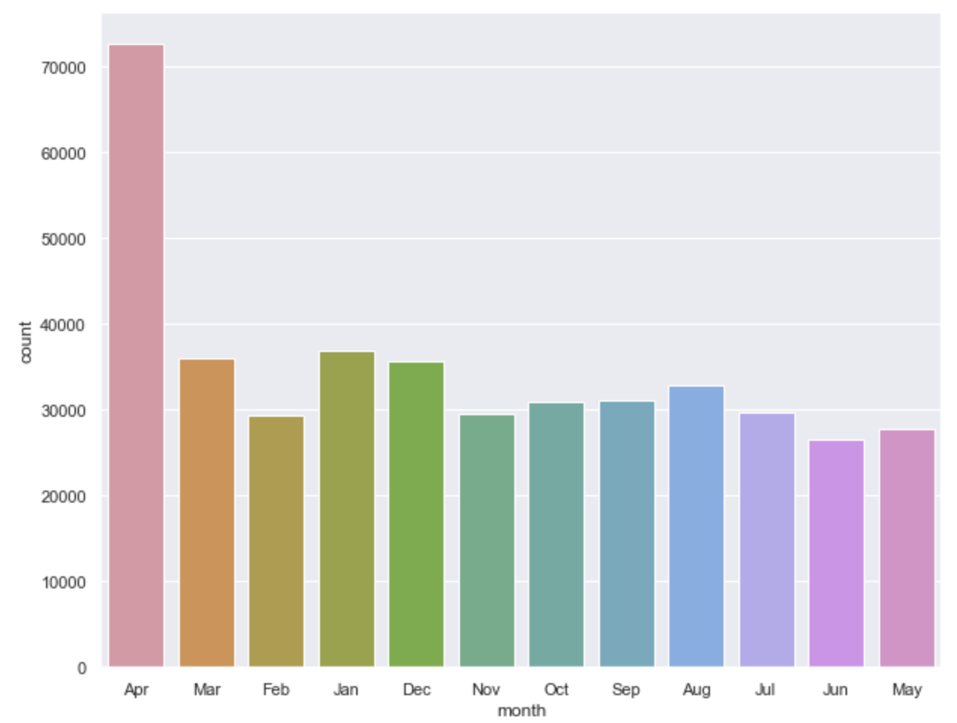
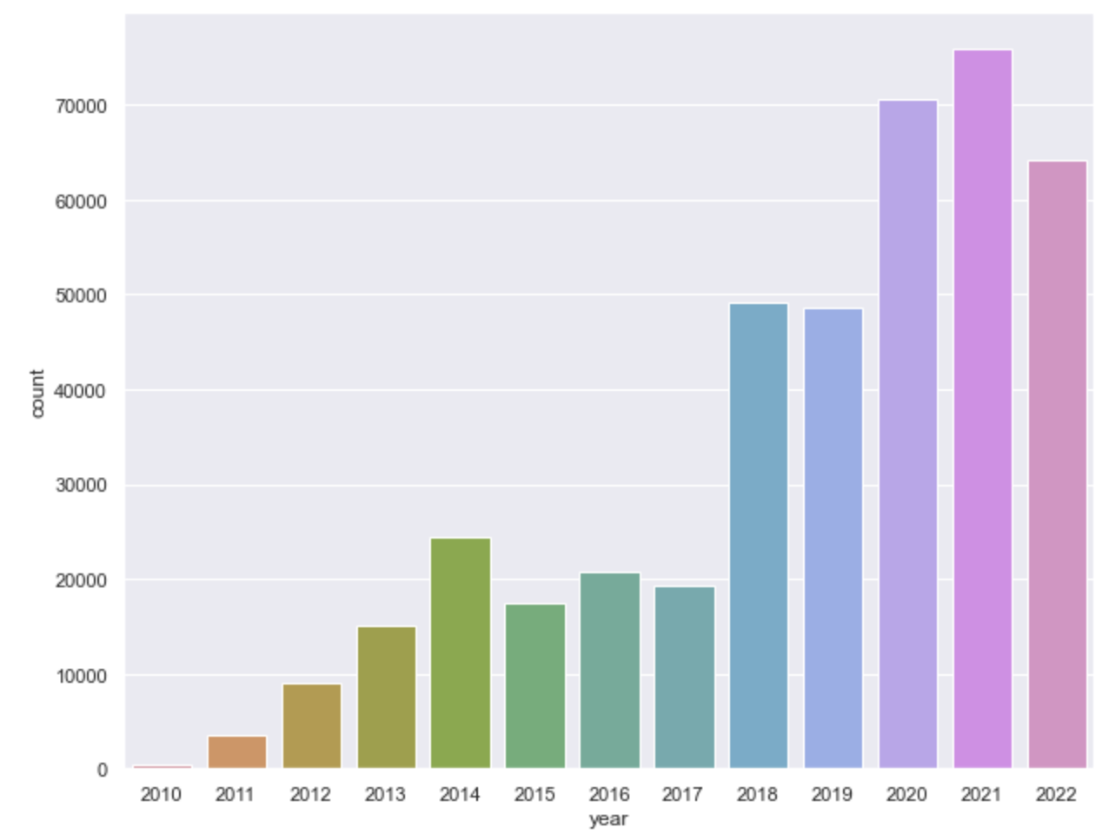
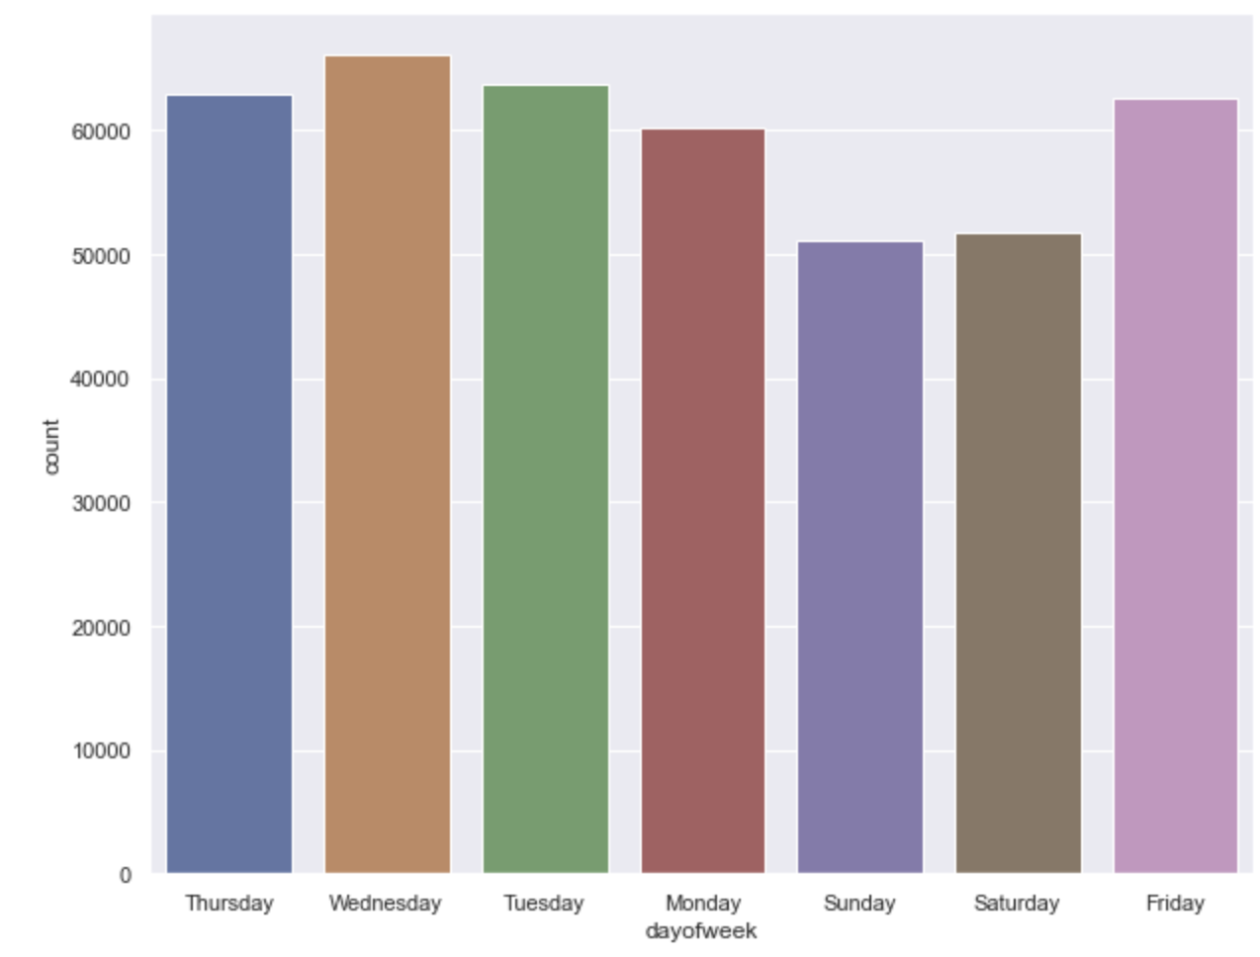
Basic Visualizations – Tweet Distribution
By Month By Year By Day of the Week

Slide 8
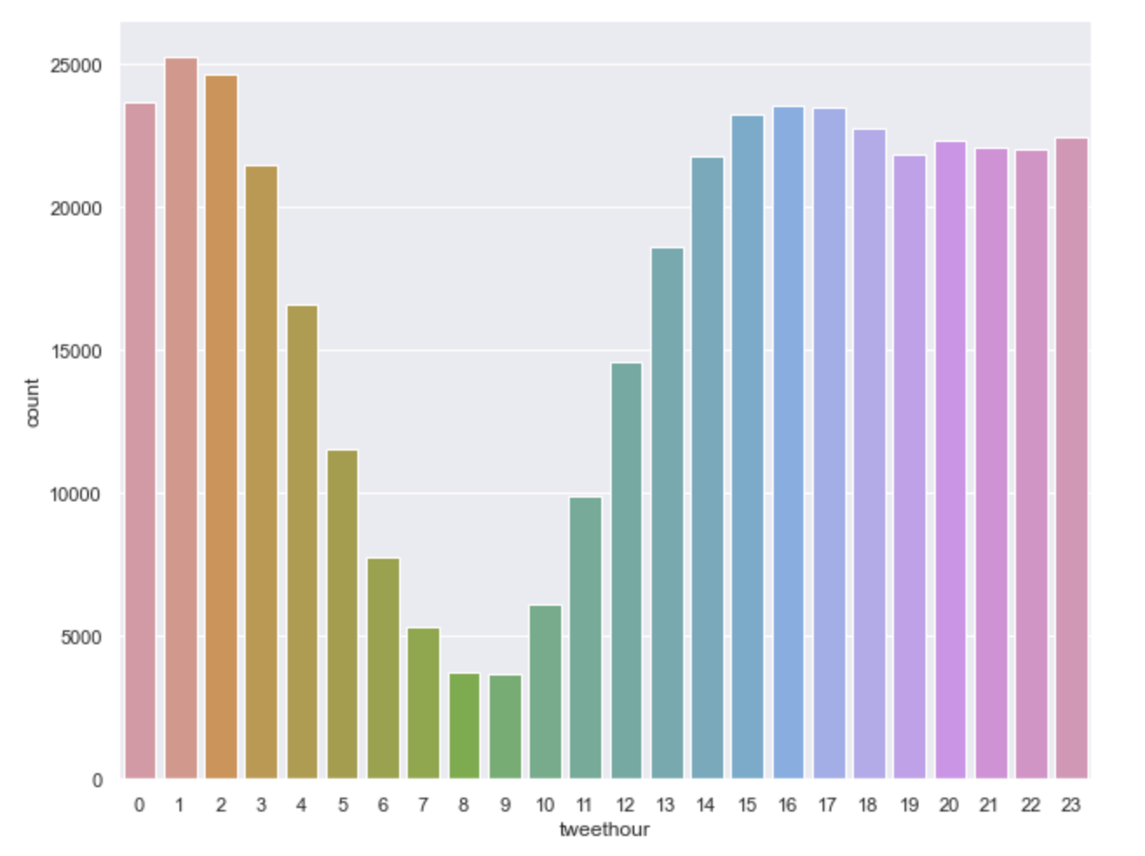
Basic Visualizations – Tweet Distribution(contd.)
By Hour of the day

Slide 9
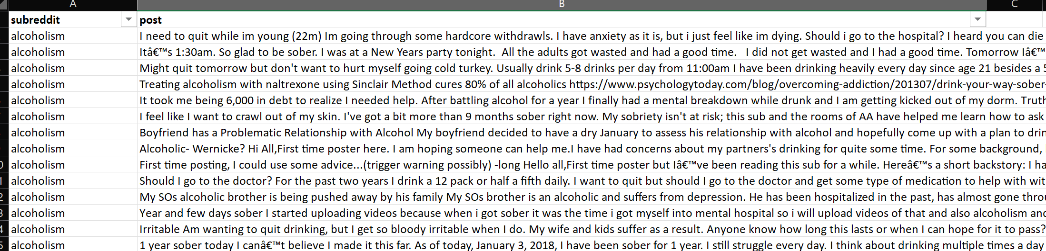
Reddit Content used for training the models
Reference - Low, D. M., Rumker, L., Torous, J., Cecchi, G., Ghosh, S. S., & Talkar, T. (2020). Natural Language Processing Reveals Vulnerable Mental Health Support Groups and Heightened Health Anxiety on Reddit During COVID-19: Observational Study. Journal of medical Internet research, 22(10), e22635
Reddit data preview –

Slide 10
Subreddits
Data from these subreddits were used-
Alcoholism
Anxiety
Bipolar
Depression
Health Anxiety
PTSD
Schizophrenia
Social Anxiety
Suicide watch
Mental Health

Slide 11
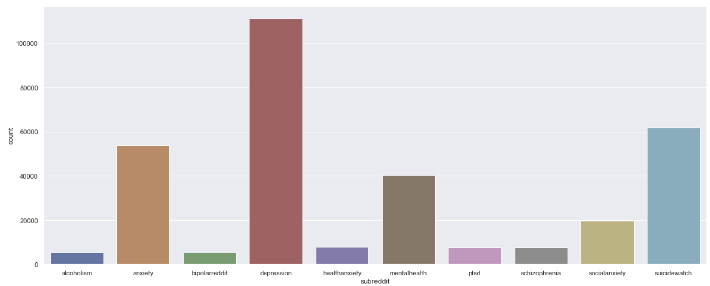
Reddit Data Distribution

Slide 12
Process and ML Models
Social media Data from Reddit’s top subreddit mental health channels were used to form a text corpus.
Reddit data was cleaned- Converted to lowercase, Punctuations removed, Tokenized, Lemmatized , Stop words removed and text was processed.
The processed text was trained for modelling using TF-IDF Vectorizer and n-grams.
This text corpus was used to train a Naïve Bayes model & a Logistic Regression model.
Used the better performing trained logistic regression model with 74% accuracy to classify our twitter data of 408K tweets.
Tweets were cleaned and processed using same approach using NLP and then the trained model was used to classify the tweets into different mental illness/issue categories. Analysis in the next slide.
MODEL | ACCURACY
Naïve Bayes | 60%
Logistic Regression | 74%

Slide 13
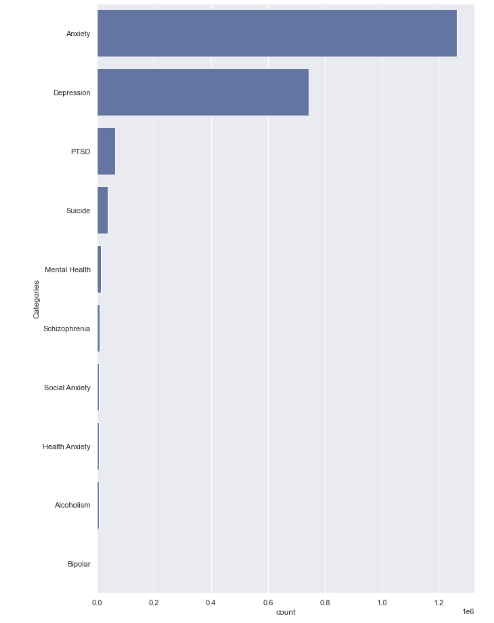
Overall Prediction Distribution
TYPE | PERCENTAGE
Anxiety | 58.78%
Depression | 34.56%
PTSD | 2.97%
Suicide | 1.70%
Mental Health | 0.64%
Schizophrenia | 0.41%
Social Anxiety | 0.31%
Health Anxiety | 0.31%
Alcoholism | 0.30%
Bipolar | 0.02%

Slide 14
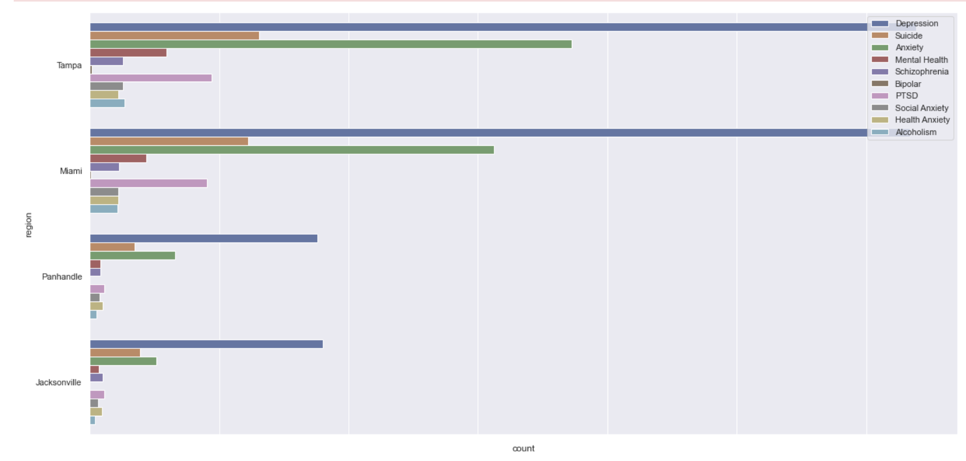
Prediction by region
Depression and Anxiety had the highest percentages in each region, way above others. Graphical representation below-

Slide 15
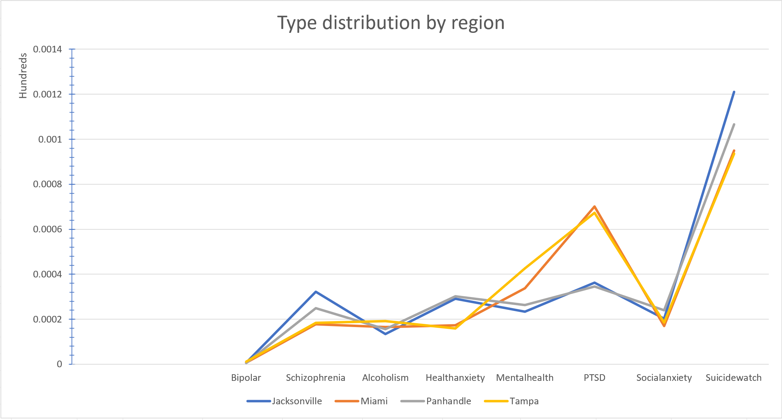
Distribution of Mental Illness type by region

Slide 16
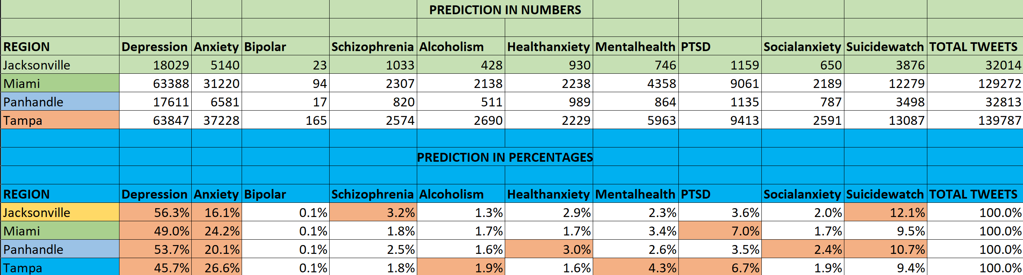
Mental Illness - Numbers vs Percentage
High scale detection of Depression & Anxiety in all regions, as this is the most common detected and diagnosed.
Jacksonville cluster has highest suicide prediction – 12.1%, followed by the Panhandle, at 10.7% in our samples.
PTSD has highest presence in the Miami cluster - 7%, followed by Tampa, at 6.7%.
Highest Schizophrenia was predicted for the Jacksonville cluster over others.
Panhandle cluster has the Health Anxiety, possibly owing to poor healthcare infrastructure availability.
Tampa region has the highest Mental Health & Alcoholism concerns over the other clusters, possibly a social lifestyle effect.

Slide 17
Recommendations
Increase Suicide Prevention lines and awareness, mainly in the local Jacksonville and Panhandle areas.
Conduct periodic surveys for mental well-being and behavioral health.
Collect this user survey data over a time period, understand mental health patterns and recommend specific health insurance plans to support them based on the highest ones in each cluster.
More health insurance options with specific behavioral therapy, group options and initial free sample sessions to encourage patient visit and sign up.
Conduct Behavior therapy sessions for those who suffer from depression & PTSD, mainly in Miami and Tampa clusters.
Conduct free/reduced cost counselling sessions to fight Anxiety with support groups.
Investment in treatment of mental illnesses has 4 times the ROI. (https://www.who.int/news/item/13-04-2016-investing-in-treatment-for-depression-and-anxiety-leads-to-fourfold-return )

Slide 18
Thank you!

